Slide 1
2017-18 School Year
A partnership between
Notes:
NOTE: Prior to training-all users should have access to the CLI Engage platform.
Teachers should have usernames and passwords and have previously logged into the system.

Slide 2
Why Do Teachers Assess? Using Data to Improve Practice
ASSESSMENT Collect data.
EVALUATION Determine next learning step.
PLANNING Choose resources and approach.
TEACHING Supports students learning.
Notes:
Say:
Why is progress monitoring a critical component of the CLI Engage platform? – it’s because we know that access to data improves teacher’s ability to plan instructional practice.
Data use models often look a lot like the teaching and learning cycle
In the cycle of effective teaching and learning, assessment is key.
Assessment: assessing the concepts or skills to determine each individual child’s level of understanding.
Evaluation: analysis of the assessment results to determine the next step in the instruction.
Planning: plan the next step and decide which approach to use and the resources needed.
Teaching: implement the plan by introducing a concept to the children or re teaching, guiding their understanding through practice and feedback.

Slide 3
Benefits
Monitor children’s progress
Document change over time
Make informed instructional decisions
Modify the instruction being delivered
Respond to children’s changing needs
Notes:
Trainer says:
Systematically monitoring children’s progress plays an important role in showing us what a child already knows and understands. When you use progress monitoring tools that give you immediate feedback, you can ensure that all children benefit from classroom instruction. Based on child progress monitoring and assessment reports, you can provide high quality, intensive instruction that has been designed specifically for individual children.
Click
When we use progress monitoring, we can:
(Read slide)

Slide 4
Assessment Overview
CIRCLE Progress Monitoring is a newly revised version of the Center for Improving the Readiness of Children for Learning and Education (CIRCLE) Phonological Awareness Language and Literacy System (C-PALLS, 2004).
Over subsequent years, the assessment system was expanded to include math (2008) and science (2013). However, educators asked CLI’s team of researchers to develop an integrated assessment system that would cover the content included in the Head Start’s Assessment Framework.
Notes:
Read Slide

Slide 5
Why CIRCLE Progress Monitoring?
Well-established reliability and validity when used with 3 and 4 year olds (relates to other tests and predicts child outcomes).
Designed to be administered quickly and yield immediate feedback and suggestions for teachers.
Texas School Ready model research demonstrates that the CIRCLE Progress Monitoring System and the activity groupings/suggestions improved child outcomes.
Notes:
Show slide
Say: The CIRCLE Assessment was designed to be used as a progress monitoring system within early childhood education settings (e.g., Head Start, Public School Pre-Kindergarten Programs and Childcare) for children ages 3.0 years through age 4 (4 years, 11 months). Current psychometric analyses focus on these age ranges. CIRCLE Progress Monitoring is a formal assessment that provides immediate feedback. Results are on the screen.
Teachers, coaches, parents and administrators can all partner together to use the data to inform instruction.
Making sound decisions for instruction based on data is not only wise but standard practice.

Slide 6
What type of assessment?
CIRCLE Progress Monitoring is a screening and progress monitoring tool.
This is not a norm-referenced measure.
It is a criterion-referenced measure to screen and monitor preschool children’s learning.
Notes:
SAY:
CLI’s assessment, the CIRCLE Progress Monitoring , is a user-friendly, online tool that allows the teacher to assess a child’s progress in a particular skill area almost instantly. This reliable yet simplistic data collection prompts teachers to focus on lessons that target their students’ least developed skill areas.
Early identification of learning needs and grouping children according those needs is known to maximize instructional impact.
Criterion referenced measures determine whether each student has achieved specific skills or concepts. Criterion referenced measures can also tell you how much students know before instruction begins and after it has finished.
(Norm –referenced measures rank each student with respect to the achievement of others in broad areas of knowledge. Norm referenced measures discriminate between high and low achievers).

Slide 7
CIRCLE Progress Monitoring
DIRECT ASSESSMENTS
OBSERVATIONAL ASSESSMENTS
Vocabulary development
Story retell and comprehension
Book and print knowledge
Letter recognition
Letter-sound correspondence
Phonological awareness
Early science skills
Early math skills
Early social studies skills
Early writing skills
Social and emotional skills
Approaches to learning
Physical health and development
Speech production and sentence skills
Motivation to read
Notes:
SAY:
The CIRCLE Progress Monitoring Tool is a Multi-dimensional measure and also includes all Head Start domains
The Direct measures can be validated and have benchmarks.
(core skills to measure may include - rapid letter naming, rapid vocabulary, Phonological Awareness, written expression, Social/Emotional, early math)
The CIRCLE Assessment Observables checklists are designed to assess growth in child behaviors that can be easily observed during day-to-day interactions between teachers and preschool students. Importantly, the checklists include attention to social and emotional domains that are not assessed with the other direct measures in CIRCLE Assessment. Understanding these domains is important for early childhood educators interested in understanding the development of the whole child across cognitive and social skills.

Slide 8
Head Start Early Learning Outcomes Framework
Notes:
CLI has added assessment components to now include all 10 essential domains of school readiness and is available in both Spanish and English (11th domain is ELL)

Slide 9
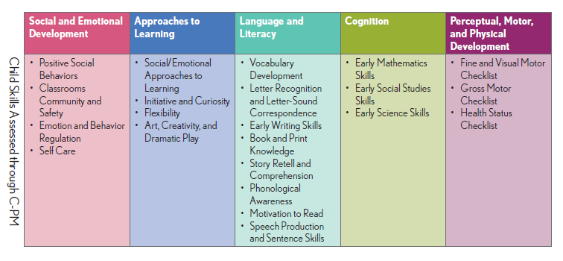
Head Start Domains and CIRCLE Progress Monitoring
Notes:
Social Emotional, Physical Development & Health, and Approaches to Learning are 3 pt. scale checklists. based on emerging, developing and proficient
Math includes:
Rote Counting, Shape Naming, Number Discrimination, Number Naming, Shape Discrimination, Counting Sets and Operations
Phonological Awareness includes:
Listening, receptive and expressive rhyming skills, syllabication, sentence segmenting, alliteration and onset rime

Slide 10
CIRCLE Progress Monitoring
Beginning of Year (Wave 1)
Middle of Year (Wave 2)
End of Year (Wave 3)
Notes:
There are three administration waves. A second wave of assessment is generally done at mid year. This is a crucial time as it will provide very needed data to provide strong intervention for those children identified as at risk and needing more intensive instruction. CLI recommends the last wave be completed with enough time in the remaining school year to address any identified needs to target additional intervention.

Slide 11
Administration Times
Measure | Assessment Type | language | Administration Time
Rapid Letter Naming | Direct | Administration instructions available in Spanish; Task measures English letters only | 2.5 mins (timed fluency task)
Rapid Vocabulary | Direct | English & Spanish | 2.5 mins (timed fluency task)
Phonological Awareness | Direct | English & Spanish | core tasks: 6 minutes optional: 4 minutes
Mathematics | Direct | English & Spanish | core tasks: 3 minutes optional: 2.5 minutes
Letter-Sound Correspondence | Direct | Administration instructions available in Spanish; Task measures English letters only | 5 minutes
Book & Print Checklist | Direct | English & Spanish | 5 minutes
Story Retell and Comprehension | Direct | English & Spanish | 10 minutes
Social Studies | Direct | English & Spanish | 8 minutes
Science | Direct | English & Spanish | 10 minutes
Notes:
SAY:
Measures were designed to be brief; no individual measure exceeds 10 minutes. Additionally, districts / schools can choose to group and sequence the administration of individual tasks to best align with their instructional schedules. This table details conservative administration times for each measure.

Slide 12
Administration Times
Measure | Assessment Type | language | Administration Time
Social Emotional Checklist | Observable | English only* | 10 minutes
Early Writing Checklist | Observable | English only* | 2 minutes
Speech Production & Sentence Skills Checklist | Observable | English only* | 2 minutes
Motivation to Read Checklist | Observable | English only* | 2 minutes
Approaches to Learning – Expanded | Observable | English only* | 6 minutes
Physical Health & Development | Observable | English only* | 6 minutes
Total direct assessment time (with student): |  |  | 58.5 minutes
Total time to complete observables: |  |  | 28 minutes
Total assessment time, all measures: |  |  | 86.5 minutes
Notes:
Allow participants time to review
Say:
Your district or community will determine which assessment measures are required. Teachers will have access to all of the assessment tasks.

Slide 13
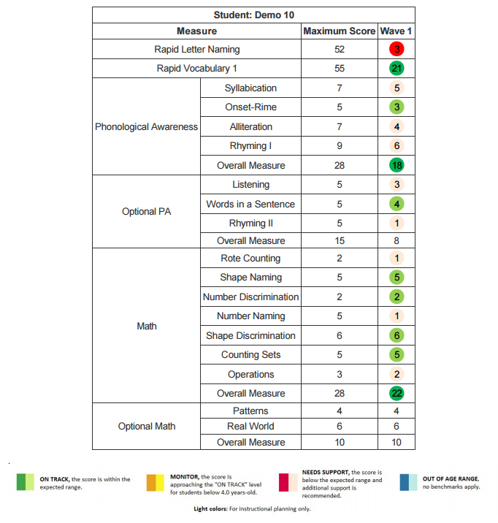
Scoring & Benchmarks
Notes:
Each assessment task yields a separate score. For most tasks that are broken into separate subtasks (e.g. social and emotional), a composite score is calculated from separate subtask scores. An exception to this rule is the Phonological Awareness task, whose composite score is drawn from four core subtasks only; the remaining three subtasks are considered optional. Similarly, the two optional math items (Patterning and Real World) are not included in the composite score.

Slide 14
Cut Points
Notes:
This table displays the cut points for each assessment according to the child’s age. If a child scores at or above the cut point listed in accordance with their age then they are considered to be at or meeting the benchmark.
. For example, the Vocabulary cut point for a child who starts the school year at age four increases from 16 at the beginning of the year wave 1 to 19 at the middle of the year wave 2, and to 22 at the end of the year wave 3.
. If a four-year-old gets 16 or more pictures named correctly at wave 1, the score is considered ‘ON TRACK’ and the score is colored green.
. If the child scores fewer than 16 correct, the score is ‘NEEDS SUPPORT’ and colored red.
. In contrast, if a child is 3.0-3.9 years old at the beginning of the school year and scores fewer than 10 correct on Vocabulary, the score is considered to need “MONITORING’ and colored yellow in the reports.
. If a child is 4.5 at wave 1 and scores 18 on vocabulary, what color is the score in the report?
. Participants answer.
. Red

Slide 15
Progress Monitoring Customization
Available in English and Spanish
Choose your own progress monitoring windows
Prioritize measures according to local needs
Exclude individual or classes of children as needed
Export data for independent analysis
Notes:
SAY:
Available in English and Spanish - This assessment is available in English and Spanish. A student can be assessed in some measures in English and others in Spanish if desired. One simply changes the language on the class view page by one click.
Choose your own progress monitoring windows - Districts and communities can choose the wave or time frame for start and end date of each of the three assessment administrations.
Prioritize measures according to local needs- Districts and communities can select which measures to assess
Exclude individual or classes of children as needed- . The exclusion button allows the user to choose to differentiate exclude select students in a classroom from specific assessment tasks. This could be useful to accommodate student differentiation.
Export data for independent analysis- Communities can export raw data for alignment in other data base systems.

Slide 16
Administering the Assessment
It is a good idea to not give the entire assessment at one time.
Break the assessment into parts. For example:
Week One: Phonological Awareness
Week Two: Rapid Letter Naming/Rapid Vocabulary
Week Three: Math Screener
Week Four: Observables (checklists)
By administering the assessment this way you are able to complete an entire class within a month’s time.
Notes:
SAY:
This slide shows a potential recommended schedule. This includes the direct measures of language and literacy components and math only. The observables are in checklist form and most do not need the child present to complete. Setting an assessment schedule is of course depending on the length of time designed for administering and the number of measures selected to assess.

Slide 17
Assessment Environment
Environment Options:
Rug
Table
Hallway
Possible settings:
Center time
Naptime
Notes:
When completing assessments, teacher should:
Complete assessments in a comfortable and relatively quiet space with minimal distractions.
Have the child sit beside them in a quiet area of the classroom to complete CIRCLE Progress Monitoring System tasks. You will need a computer, laptop, or tablet that has a reliable Internet connection.
Place the computer in a positon that allows you to operate the keyboard while you and the child look the screen. Note: The child should not see the screen during the phonological awareness assessments
There are also a multitude of options for assessing within the classroom:
While students are actively engaged in center activities you can identify individual students to come to a small group area;
Assessments can occur on the rug, at a table, or even in the hallway if there are two people in the room.
Some teachers have success completing assessments during student nap time.
It’s a good idea to let the students know that you will be playing a game and what the rules are for interrupting you if needed. You can place a cone on the table, or wear a badge or a hat, for example, to signify that you are unavailable while engaged in the assessment.

Slide 18
Assessment Environment
Have the child sit beside you in a quiet area of the classroom to complete CIRCLE Progress Monitoring tasks.
Place the computer in a position that allows you to operate the keyboard while you and the child look at the screen.
Note: The child should not see the screen during the phonological awareness assessments.
Notes:
Read slide and explain (read below)
Have the child sit beside you in a quiet area of the classroom to complete CIRCLE Progress Monitoring tasks. There are a number of ways to consider administration. While students are in centers, the teacher may call individual students to a small group table area. Let children know that you are busy ‘playing a game’ or working with the one student and not to be disturbed by placing a cone or other object on the table or putting on a special hat or wearing a special pin that indicates you are occupied.
Place the computer in a position that allows you to operate the keyboard while you and the child look at the screen. The child interacts with the screen by providing a response or pointing to a stimuli.
*Note: The child should not see the screen during the phonological awareness assessments. Phonological Awareness is auditory.

Slide 19
Do’s & Don’ts of Assessment Administration
Praise effort.
Read instructions exactly as written.
Become comfortable with tasks before administering them.
Use prompts like “Listen carefully” to regain child's focus.
Model the practice activity if warranted.
Remain calm and steady.
Make notes after completing assessments.
Don't provide hints.
Don't elicit additional information.
Don't change instructions.
Don't assess children who are feeling sick, distraught, or overly oppositional.
Do not try to delete the assessment and change the answers
Do not model for a child once you have begun the assessment
Notes:
NOTE TO TRAINER
Participants take 1̶‒2 minutes to read through the list of Do’s and Don’t.
SAY:
Do’s
Praise efforts, not success.
PARAPHRASE:
Praise effort, not success. A child should not be able to tell if he or she got an item correct or incorrect.
If a child is uncertain about instructions, it is acceptable to read the instructions again.
Read all instructions exactly as written.
Read the instructions again if a child is uncertain about them.
Be comfortable about the pace. Some assessments are timed.
Maintain and regain the child’s focus. Say things like, “Listen carefully.”
Remain calm and steady for children; especially with those who are emotional.
Minimize distractions. Try to assess during a time when other students are not around, and limit distractions.
Model the practice activity for the students.
Don’ts
Do not give hints (i.e. nodding, clapping, tapping, yes/no responses) when administering the assessment.
Don't give hints to the child, or give praise that indicates how the child is doing/scoring. Do not repeatedly say “okay/bien” between items.
Do not try to give additional information (i.e. we covered this last week, this letter makes this sound, this number comes after).
Do not change the instructions.
Do not assess while a child is sick, distraught, or in a fowl mood.
Do not try to delete the assessment and change the answers. True results are more effective.
Do not continuously click the keys when administering a timed test.
Do not model a skill for a child once you have begun the assessment. The practice time is the only time.
Do not use facial expressions that reveal how the child is doing.
Do not give high fives during a test/between items.
Don’t change the instructions in any way – the administration should be consistent and standardized no matter which examiner gives the test.

Slide 20
Assessment Do’s and Don’ts: Thumbs Up or Thumbs Down?
You are working hard.
Great!
You are doing a great job paying attention.
I can tell you’re working hard.
Right.
You’re so smart.
Notes:
Ask:
(Allow participants to ask any questions if they are unclear on any items in the list).
How could a teacher who doesn’t follow the Assessment Do’s and Don’ts affect assessment results?
Praise effort, not success. A child should not be able to tell if he or she got an item correct or incorrect. Some examples are:
“You are working hard.”
“You are doing a great job paying attention.”
“I am proud of your hard work.”
“You’re behaving so nicely.”
“Good listening.”
“I’m having fun playing these games with you.”
“You’re paying attention so well.”
“I can tell you’re working hard.”
Don’ts
Do not give hints (i.e. nodding, clapping, tapping, yes/no responses) when administering the assessment.
Don't give hints to the child, or give praise that indicates how the child is doing/scoring. For example DO NOT say:
“Good”
“Great”
“Right”
“Uh-huh”
“You’re so smart”
Do not repeatedly say “okay/bien” between items.

Slide 21
Technology Essentials
To access the CLI Engage platform, you will need the following:
Desktop Computer, Laptop, or Tablet
Assessment cannot be administered on a device with a screen smaller than 11”.
Internet Access
Assessment can be administered offline.
The assessment can be administered on all hardware using any browser
Notes:
Discuss Slide

Slide 22
Offline Assessment
Notes:
SAY:
Internet Access
The assessment can be administered offline. Find instructions for creating a personal pin # and downloading data on the student view page.
Other information if needed:
To use offline assessment:
Login to CLI Engage and find the appropriate classroom in the CIRCLE Progress Monitoring System.
While on the Student View page, click on the Offline Assessment button.
Create a 6-10 character Personal Identification Number (PIN) with at least one number and upper case letter and then click OK. Note: this Pin should NOT be your Engage login password.
The data for the Offline Assessment will automatically begin to download. Click OK on the popup ‘Resource download is complete.’
Bookmark the Offline Assessment page (https://assessment.cliengage.org/Offline) in your browser.
When you are ready to test Offline:
Click on the browser Bookmark.
Type your personal PIN Code into the box and then click Unlock.
Assess students as needed while offline.
When you are done testing offline and have an internet connection again:
The sync buttons will become active (not greyed out). Click the button to sync offline data for all students at once or the individual sync icon next to specific students to sync one at a time.
You will be prompted to Log In again to Engage. Click OK.
Once you have logged in, the data will automatically sync.

Slide 23
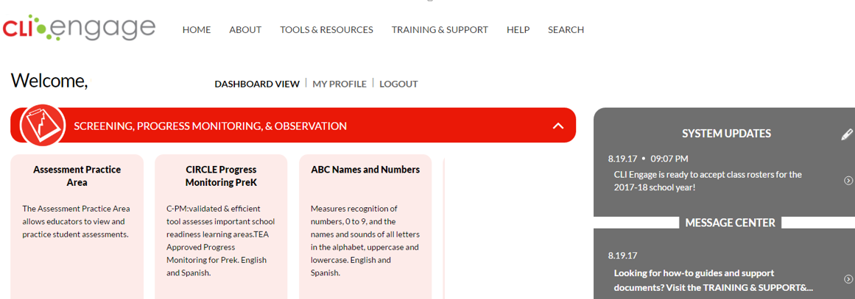
CLI Engage Dashboard
Teachers will see a dashboard after logging in to www.cliengage.org
Notes:
Say:
This is the dashboard that teachers will see once they log on to the platform. Select the CIRCLE Progress Monitoring PreK assessment tab to access the CIRCLE Progress Monitoring.
The Assessment Practice Area can be used for training. It contains 10 demo students with mock data and 5 practice students to practice administering the assessment.

Slide 24
Select CIRCLE Progress Monitoring PreK
Notes:
For this training we will use the assessment practice area. When you are ready to assess and your students have been uploaded into Engage, you can begin the assessment CIRCLE Progress Monitoring PreK.
You will, also, see a tab titled ABC Names and Numbers which is an additional option for number naming that is untimed and includes visual stimuli of digits 0-9. Letter names provides visual stimuli of all upper case and lower letters of the alphabet with no time limit. The Letter sounds section measures the sounds of all the letters in the alphabet, upper and lower case, with no time limit.
It is strongly recommended that the brief items on the CIRCLE Progress Monitoring PreK assessment be used as they are benchmarked and can provide a valid indicator if the child is acquiring these three skills using a smaller set of sensitive sample items.

Slide 25
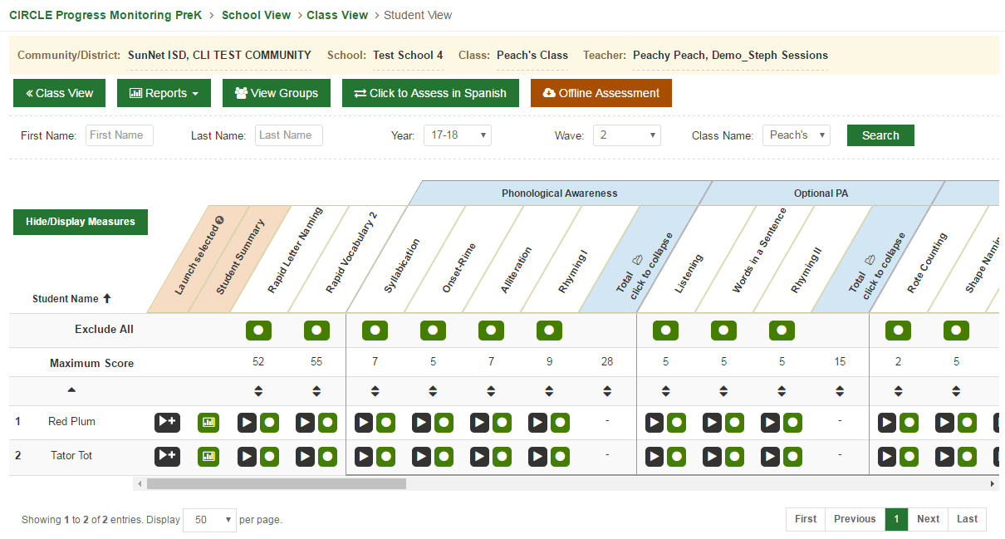
Class View Page
Notes:
Say:
LOCATE Community/District name School name , class name Teacher name,
LOCATE list of students
LOCATE assessment measures
LOCATE launch buttons and exclude buttons

Slide 26
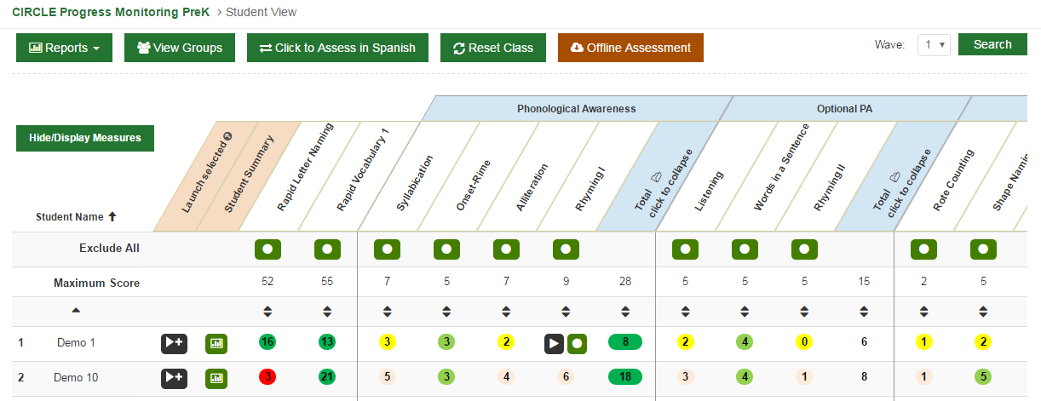
Select language
of assessment
Reports are available immediately
after assessment completion
Select the appropriate
“Wave”
Notes:
Say:
Assessment feedback / results are available immediately after assessment completion. Clicking on the reports tab links you to multiple report options.
Click the language of assessment button to switch from English to Spanish or Spanish to English. General guidance is one should assess in the language of instruction.
Click on the wave and set to wave 1 , 2 or 3 on the drop down. The system will remember the User’s last wave selection.

Slide 27
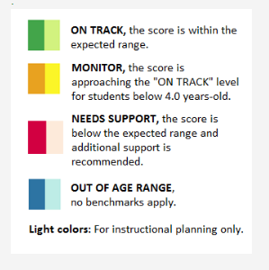
A table to the left of the assessment display explains each button/color
Notes:
Say:
There are color-coded levels of understanding based on benchmarks.
(Read each item on table).
Say:
Children’s age as of September 1st is used to determine which set of cut scores (benchmarks) are examined for an individual child. For instance, in the vocabulary measure, a child assessed with the English version of C-PM who is 4 years, 2 months at the beginning of the school year would be considered to be at risk if he or she knows less than 16 words at the beginning of the year, less than 19 words during the middle of the year, or less than 22 words at the end of the year.

Slide 28
Launching an Assessment
Select multiple subtests and click “launch selected”
or
Select an individual subtest and click the “launch” button underneath the header
Notes:
Read slide

Slide 29
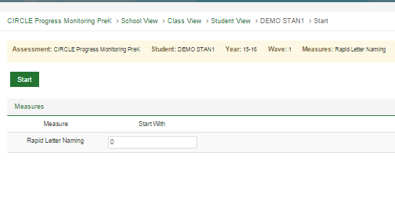
Extra Screen after “Launch”
Launch the assessment.
Skip the first screen by clicking “start.”
This is a screen you will see in each measure. Please click “start” to proceed with the assessment.
Notes:
Say:
This screen will appear before all measures. Please click “start” to proceed with the assessment.

Slide 30
Rapid Letter Naming
This assessment is given to evaluate a student’s ability to identify the alphabet.
The Rapid Letter Naming assessments are timed assessments.
The students will be given a total of 60 seconds to respond to the letters that appear on the screen.
Students must respond within 3 seconds. If 3 seconds elapse without a response it is automatically scored as incorrect.
When to Record the Response:
If the child correctly names the letter
If the child says “I don’t know”
If the child provides an incorrect response
Notes:
SAY:
This is a 60-second timed assessment that provides a snapshot of what a child knows at that given time.
Explain automaticity:
Letter knowledge, phonological awareness skills, and general language abilities are some of the key building blocks of early reading skills (i.e., what some refer to as “the big three of reading of early reading”). Research has indicated that the automaticity of letter recall is important for reading skills. For early readers this means that letter shapes have letter names and “….these associations need to be overlearned in order to support later rapid fluent letter reading that leads to word reading accuracy, word reading fluency, and reading comprehension.” (The International Dyslexia Association quarterly newsletter, Perspectives, Winter 2003, pages 27 - 31, by Graham F. Neuhaus) The CIRCLE Progress Monitoring was developed to evaluate a child’s ability to name letters within a time sensitive format that would provide a measure of automaticity or speed of recall. This was accomplished in the Rapid Letter Naming task by introducing a time component. Specifically, the subtest evaluates the number of upper and lower case letters that a child can name in 60 seconds. In electronic administrations (e.g., laptop, desktop, netbook) the timing demands are controlled by the technology, making the task significantly less cumbersome to administer as compared to paper and pencil administrations.

Slide 31
Instructions to Assessor
Notes:
Say:
The first screen that appears after “start” provides information on how the measure will appear and any preparations prior to assessment

Slide 32
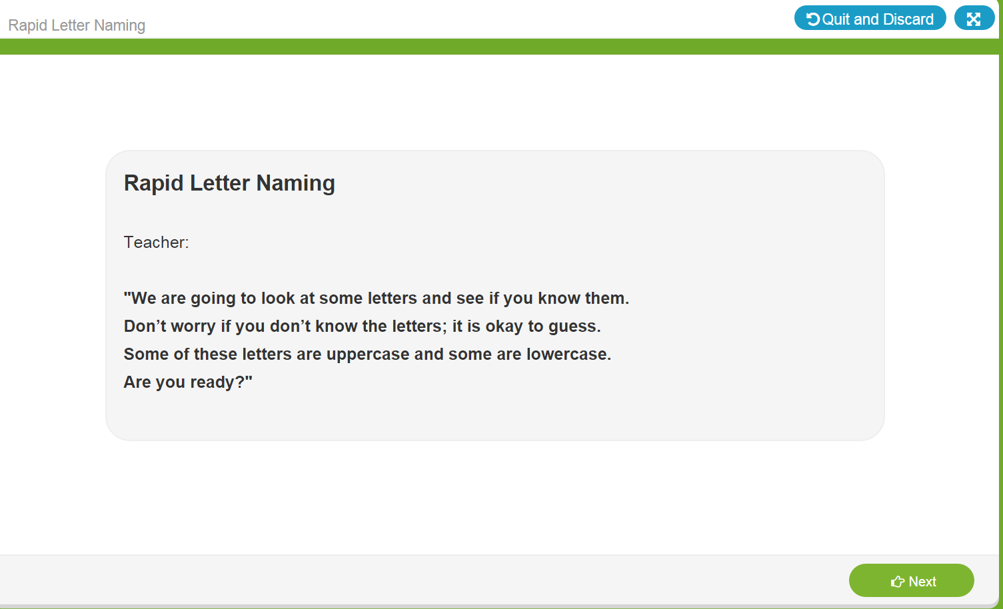
Introductory Page
Initial Instructions to student
Click “next” to launch timed assessment
Notes:
Say:
The next screen provides specific instructions to the assessor on exactly what to say to the student. It is important to stick to the script to ensure the student is not coached or given additional information that would influence the assessment results.

Slide 33
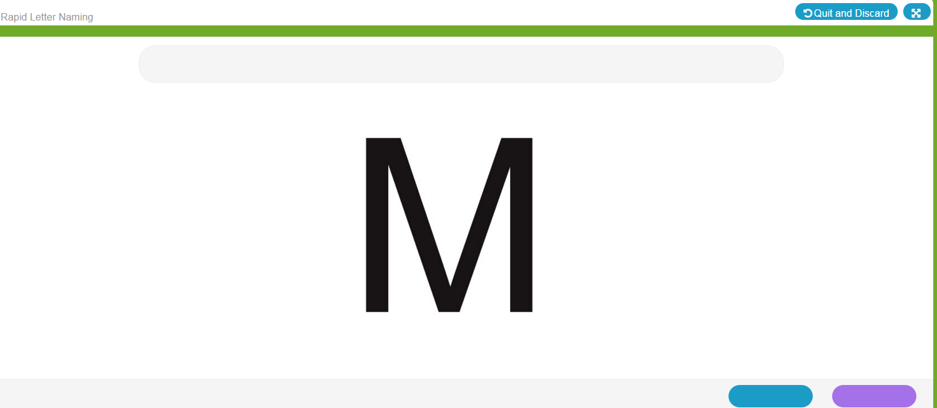
Sample Stimulus
Each item is timed - Students have 3 seconds to respond, Teacher has 1 second to key the response
Scoring Procedures:
Click blue if the student gave the incorrect response.
Click purple if the student gave the correct response.
Quick Key:
Left Arrow- Incorrect Response
Right Arrow – Correct Response
Notes:
Read notes on the right side of the slide.
Say:
The letters appear randomized but are the same order each subsequent assessment

Slide 34
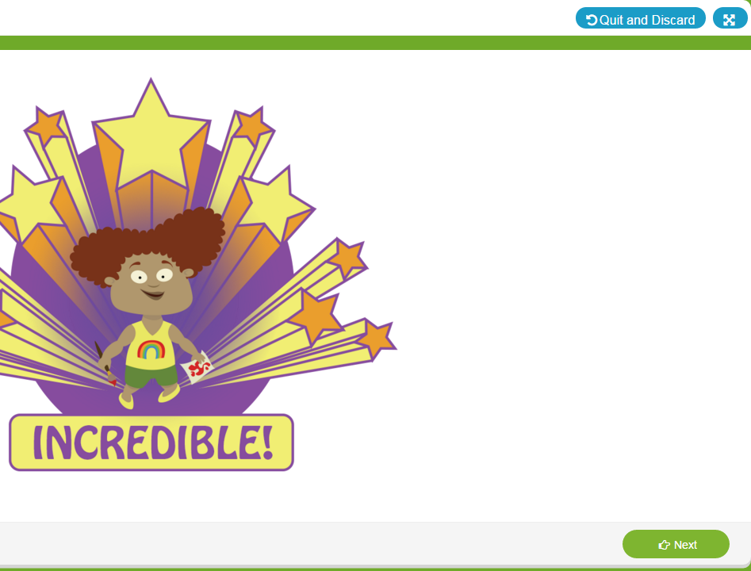
Closing Screen for Students
Notes:
Say:
There is a closing screen after each assessment is completed.

Slide 35
Itemized Report with Comment Feature
Notes:
Point out each feature and explain:
Student score- this indicates how many correct responses of the total were answered correctly.
Clicking done will advance to the next assessment selected.

Slide 36
Invalidating an Assessment
Only invalidate an assessment if a scoring error was made by the teacher.
Do not reassess the child for several days to avoid “practice” effect.
Notes:
SAY:
This process is consistent will all measure types.
(Read notes on left side of screen).
SAY:
You may also want to invalidate if the student is completely inattentive, i.e., distressed, sick etc. or an interference such as a fire drill or emergency distraction prevents you from proceeding.

Slide 37
Teacher can only invalidate when viewing results and before click “DONE”

Slide 38
VIEW RESULTS
Notes:
Note that once you click “done,” you can view results but the teacher can no longer invalidate the assessment. Community or District Administrators with Community District user roles can invalidate a measure if need. This might be in the case of a teacher having assessed the wrong student.

Slide 39
Rapid Vocabulary Naming
These assessments are given to evaluate a student’s ability to identify vocabulary.
The Rapid Vocabulary assessments are timed assessments.
The students will be given a total of 60 seconds to respond to the pictures that appear on the screen.
Students must respond within 3 seconds. If 3 seconds elapse without a response it is automatically scored as incorrect.
When to Record the Response:
If the child correctly names the picture
If the child says “I don’t know”
If the child provides an incorrect response
Notes:
Read slide
Say:
The Rapid Vocabulary Naming subtest utilizes procedures that are very similar to those for the Rapid Letter Naming subtest of CIRCLE Progress Monitoring. Specifically, children’s vocabulary knowledge is evaluated within a timed format (i.e., 60 seconds of stimulus time). The images that children are asked to name were derived from evaluation of vocabulary words within multiple pre-Kindergarten curricula. While some of the words might be considered to be more difficult for 4 year old children to identify, items were included that mapped onto content presented in commercially available curricula. Unlike the Rapid Letter Naming subtest, there are three separate sets of vocabulary items with 55 pictures in each. Pictures are randomly shown and are in ranges of easy, medium and harder difficulty.
The vocabulary pictures are black and white.
A complete list of acceptable responses for both English and Spanish words is found on the resources page.
The Rapid Vocabulary Naming subtest does accept multiple forms of a word as correct (e.g., for a picture of a man running, correct responses could include run, running, or runner). In addition, children should not be penalized for poor articulation (e.g., “lawnmober” is said for lawnmower or “ippopotamus” is said for hippopotamus). This rule was adopted due to the fact that articulation errors are fairly common in young children. A general guideline in terms of pronunciation can be stated as follows: Give credit for the item if another reasonable person would easily be able to decipher that the child was correctly identifying the picture.

Slide 40
Rapid Vocabulary Score Sheets
CIRCLE Progress Monitoring System
Notes:
There are scoresheets available for each wave administration of the vocabulary (both in Eng and Span) that list acceptable responses. These score sheets along with other resources such as the story retell response record can be found under the Training and Support tab on the dashboard.

Slide 41
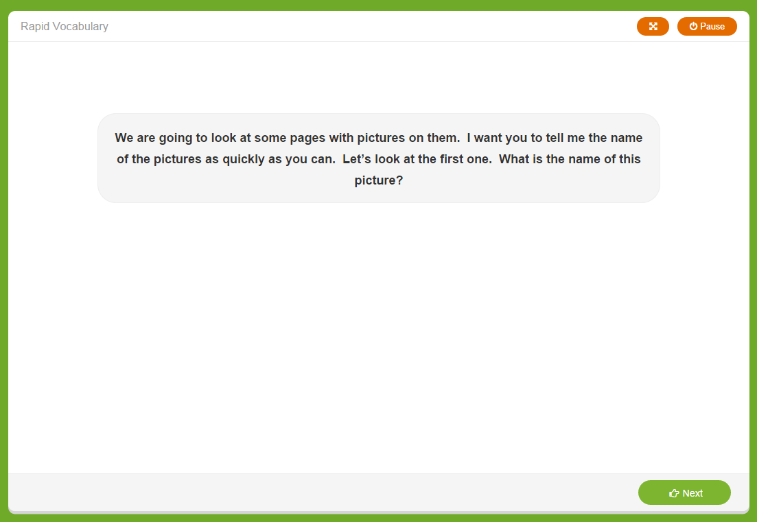
Introductory Screen
Initial Instructions
Click “next” to launch the untimed sample items
Notes:
Say:
These are the initial instructions for the student as read by the assessor.

Slide 42
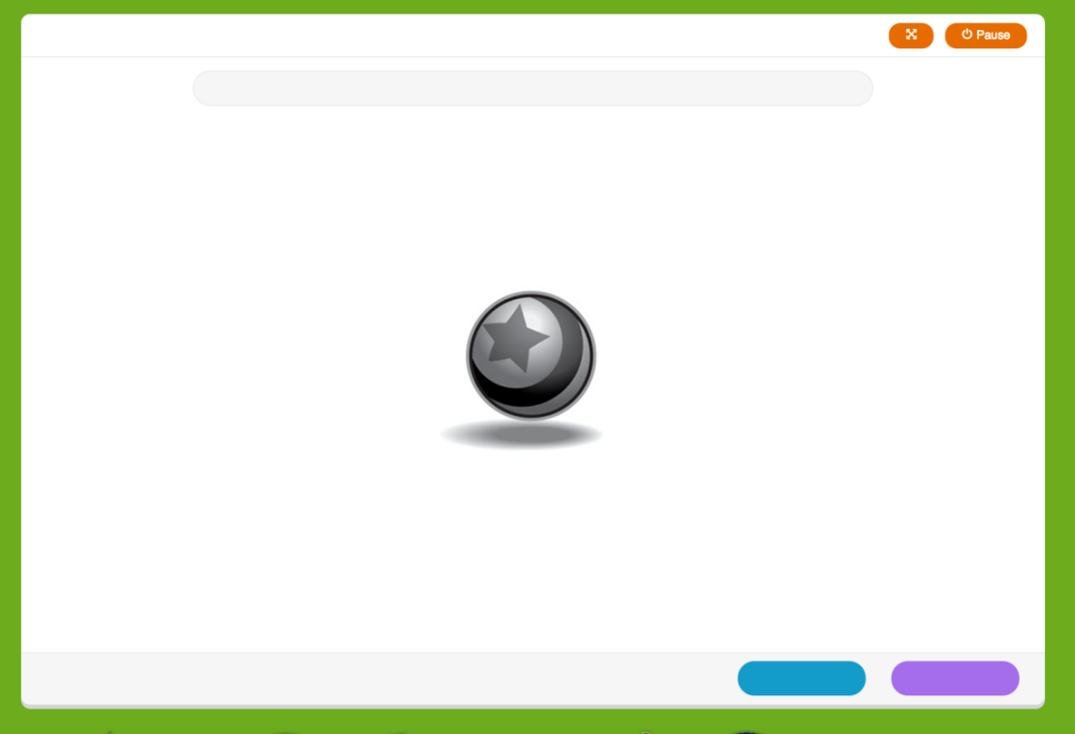
Warm-up Items
2 untimed warm-up items prior to the start of the timed assessment.
Click blue if the student gave the incorrect response.
Click purple if the student gave the correct response.
Quick Key:
Left Arrow- Incorrect Response
Right Arrow – Correct Response
“Right is right!”
Give feedback for both practice items:
Correct response: “Good job.”
Incorrect response: “That was a good try, but this is a ball. Let’s try some more. You say ‘ball.’
Notes:
There are 2 untimed warm-up items.
-Click blue for “incorrect”
-Click purple for “correct”

Slide 43
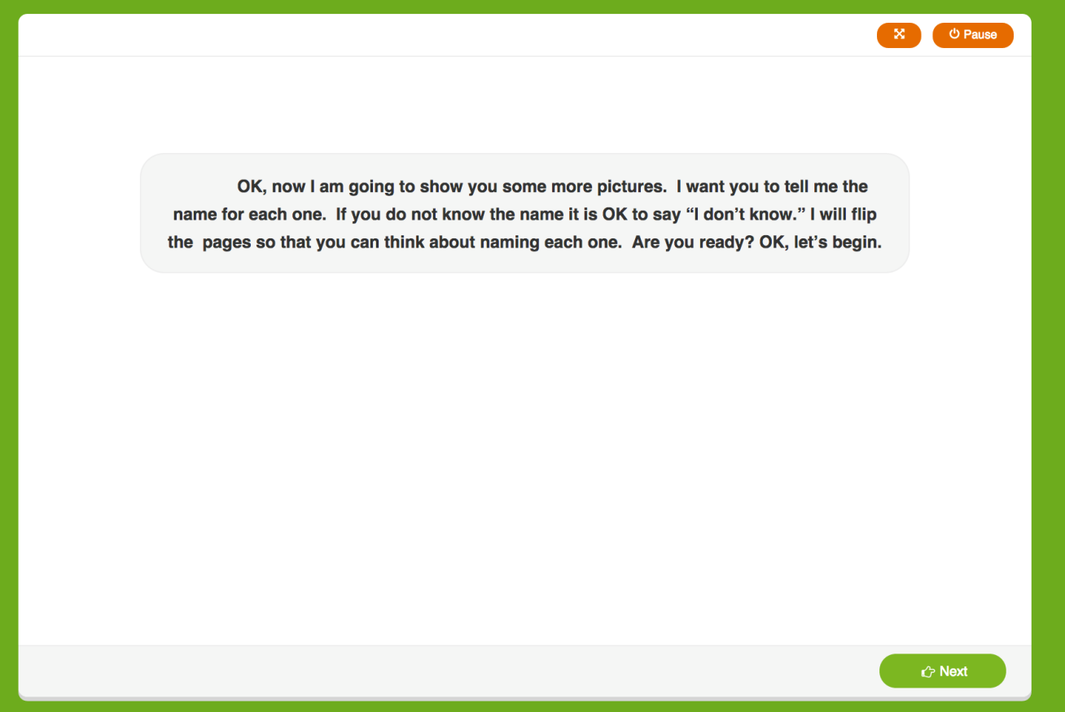
“Ready” Screen
Additional instructions for teacher to read aloud.
The teacher prompts are given on the screen and will guide the teacher through the assessment.
Child views assessment item on the screen.
Click “next” to launch the timed assessment.
Notes:
-Additional instructions for student.
-Click “next” to launch the timed assessment.

Slide 44
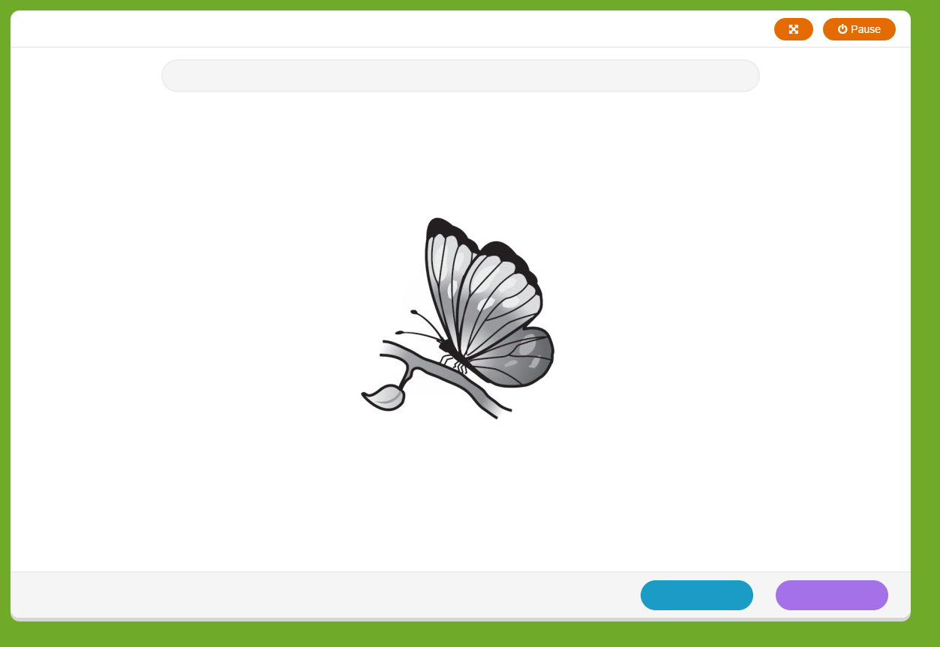
Sample Item
Each item is timed - Students have 3 seconds to respond, Teacher has 1 second to key the response
Scoring Responses:
Click blue if the student gave the incorrect response.
Click purple if the student gave the correct response.
You cannot correct responses without invalidating the assessment on the final screen.
Notes:
Say:
advance to the next screen when
the child correctly labels a picture
• If the child says “I don’t know”
• If the child provides an incorrect response
• If 3 seconds elapse (auto advances)

Slide 45
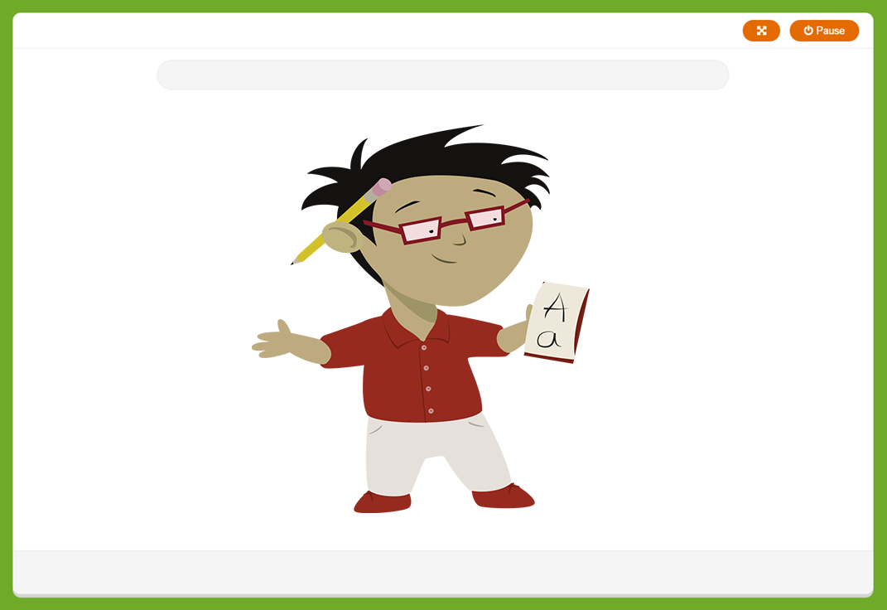
Closing Screen for Student

Slide 46
Results Screen
Notes:
Say:
Results are shown at the conclusion. There is an option to invalidate the entire assessment before proceeding. Otherwise the assessment is retained as complete. The assessor can add typed comments to the assessment by clicking on the Comment button. Comments are recorded at the bottom of the page.

Slide 47
Rapid Vocabulary Naming Administration Video
Click link to view:
https://content.jwplatform.com/previews/WbIlgBAx-3dQYJPp5
Notes:
Watch Video-Discuss concerns from video assessment….

Slide 48
Rapid Vocabulary Group Practice
Log into the ASSESSMENT PRACTICE AREA and click on the Rapid Vocabulary assessment.
Practice the assessment on your own.
Notes:
Work with groups address any issues as they practice the assessment in Vocabulary
Note: Participants may discuss afterwards if on an on-line discussion.

Slide 49
Phonological Awareness
This measure is used to assess a child’s understanding of sound in his/her language.
The Phonological Awareness assessments are not timed assessments.
The child does not look at the screen. This is an auditory assessment.
Note: It’s very important when scoring that the teacher be aware of what the correct answer from the child is. Sometimes the correct answer will be “no” and sometimes the correct answer will be “yes”.
Notes:
Say:
Phonological Awareness is the ability to detect the sounds in language without thinking about the meaning of what is said. It is considered a precursor to phonics and is a skill that is needed to learn phonics. In the Progress Monitoring Assessment, Phonological Awareness gauges a child’s understanding of how the sounds of spoken language can be segmented, combined and manipulated. --- Reminder that students should not see the screen for this assessment.
Read the slide.
** Onset/Rime is only administered to English speaking students. Spanish speaking students are exempt from this portion of the assessment.

Slide 50
Phonological Awareness Subtests
Receptive Rhyming | Ability to distinguish if two words rhyme when spoken
Syllabication | Ability to separate a word into its parts
Onset-Rime | Ability to blend two parts of a word together when segmented between the beginning consonant(s) and the rest of the word
Alliteration | Ability to distinguish two or more words that have the same sound(s) at the beginning of the words
Optional subtasks
Expressive Rhyming | Ability to independently give a word that rhymes with the word given
Listening | Ability to screen out other noises and selectively focus attention on a specific sound
Words in a Sentence | Ability to move counters to show how many words are in a sentence
Notes:
Say:
The Phonological Awareness (PA) measure consists of seven total subtasks used to assess a child’s understanding of sound in either English. In the Spanish assessment there are 6 subtasks because there is no Onset Rime.
Currently, a composite PA score is established from the following four subtasks only (core tasks): Syllabication, onset-rime, Alliteration and Rhyming 1 (receptive).
The remaining three subtasks are optional for teachers (i.e., they are not used when establishing the composite PA score). The Listening and Words in a Sentence tasks may be helpful when assessing students who demonstrate a lower level of skill on the core tasks listed above. Rhyming 2 (expressive) may be useful for students who demonstrate a higher level of skill on the core tasks.

Slide 51
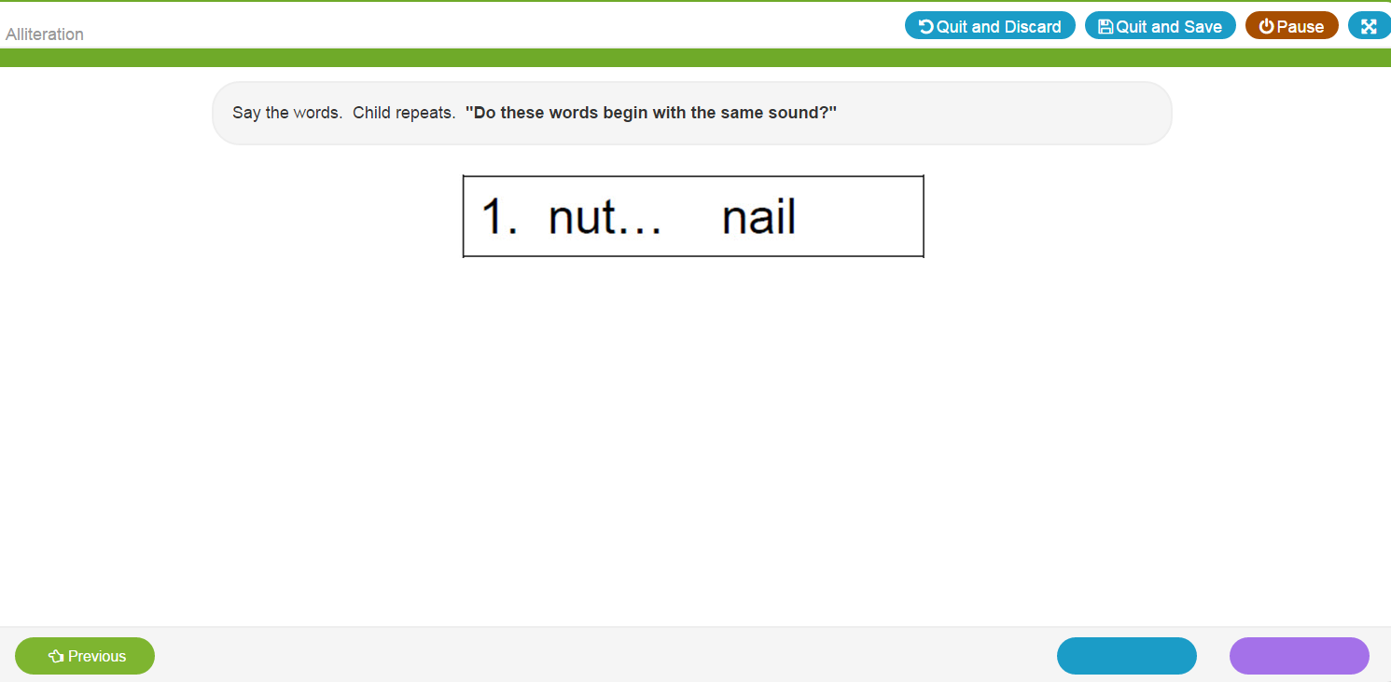
Sample Item
The teacher prompts are given on the screen and will guide the teacher through the assessment.
Scoring Responses:
Click blue if the student gave the incorrect response.
Click purple if the student gave the correct response.
or
Left arrow for incorrect and right arrow for correct (right)
Notes:
Read the notes on the right side of slide.

Slide 52
Results Screen
Notes:
Say:
This results screen shows all of the items the child responded within the administration. Correct scored are indicted with a “1” incorrect responses (or elapsed item with no response) is indicated with a “0”

Slide 53
Phonological Awareness Administration Videos
Click the links to view administration videos for the following assessments for Phonological Awareness. After the each video, log into the assessment and practice each component.
Listening
https://content.jwplatform.com/previews/dRxFzChk-3dQYJPp5
Rhyming I
https://content.jwplatform.com/previews/hsuieDMm-3dQYJPp5
Rhyming II
https://content.jwplatform.com/previews/Qr4pjxgp-3dQYJPp5
Note: Participants may discuss afterwards if on an online discussion.
Notes:
Begin with the Listening component of Phonological Awareness.-View video, pause after assessment to allow teacher an opportunity to log into the system and conduct the Listening Assessment under Phonological Awareness as they watch the video and record same responses. Have a discussion with teachers about their experience while doing the assessment.
Possible questions: What was difficult about administrating the assessment?
What went well?
Over all impressions?
Continue viewing the videos-pausing after each component to give teachers an opportunity to practice the assessment. Follow up with discussions for each section.
…

Slide 54
Phonological Awareness Administration Videos
Click the links to view administration videos for the following assessments for Phonological Awareness. After the each video, log into the assessment and practice each component.
Alliteration
https://content.jwplatform.com/previews/qFSqfQ5E-3dQYJPp5
Words in a Sentence
https://content.jwplatform.com/previews/USb9ah9g-3dQYJPp5
Syllabication
https://content.jwplatform.com/previews/WlEmDRTt-3dQYJPp5
Notes:
View video, pause after assessment to allow teacher an opportunity to log into the system and conduct the alliteration Assessment under Phonological Awareness. Continue practicing with each video. Have a discussion with teachers about their experience while doing the assessment.
Possible questions: What was difficult about administrating the assessment?
What went well?
Over all impressions?
Continue viewing the videos-pausing after each component to give teachers an opportunity to practice the assessment. Follow up with discussions for each section.
Notes for sentence segmentation:
SAY:
It is acceptable to have the child repeat the task one additional time to reinforce the concept.
• Remember to have the child repeat the sentence prior to attempting to move the blocks. This ensures that the child has heard the sentence accurately.
• Score only the final number of blocks moved by the child. For example for the sentence “Mother reads to me”, a child might move two blocks while saying the word “Mother” and two blocks while saying “reads to me” (i.e., a total of 4 blocks moved). In this example the child moved 4 blocks and would receive credit for the item, even though they did not move one block for each specific word.
…

Slide 55
Phonological Awareness Group Practice
Log into ASSESSMENT PRACTICE AREA and click on any of the Phonological Awareness assessments.
Practice each Phonological Awareness assessment on your own.
Notes:
Work with teachers as they complete Phonological Awareness assessments…

Slide 56
Math Component
The Math Screener is designed to diagnose strengths and weaknesses and to help focus instruction on specific areas of the child’s needs.
This assessment is not a timed assessment. The subtasks are linked for continuation.
This assessment covers multiple tasks to assess a child’s understanding of math skills.
Notes:
Read slide
Say:
The math tasks are aligned to the Texas Pre K Guidelines for math

Slide 57
Math Tasks in CIRCLE PM
Rote Counting | Students successfully counts to the highest number in consecutive order
Set Counting | Students counts the number of items on the screen and give the number verbally
Number Naming | Students say the name of the number in the picture or the number shown
Number Discrimination | Students will identify the picture of a number.
Shape Discrimination | Students will identify pictures of specific shapes among other shapes
Shape Naming | Students identify pictures of shapes
Operations | Students use addition and subtraction to respond the the question while referring to pictures on the screen
Patterns | Students identify next item in pattern
Real World | Students identify position in a sequence, measurement size and quantity from a series of pictures
Notes:
Review components of Math Assessment…
Say:
The math test includes 26 items that evaluate skills across multiple domains considered to be important by the National Council of Teachers of Mathematics including counting (i.e., rote counting and counting sets), shape naming, operations, number identification, and shape discrimination. Optional measures include patterning and measurement concepts.

Slide 58
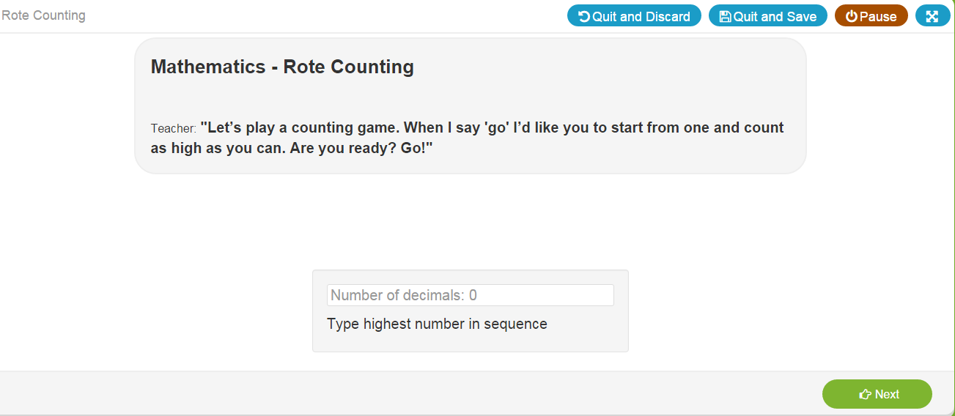
Task: Rote Counting
Give the directions to the child
Record highest response
(up to 99)
Click “next” to proceed.
Note: Repeat item up to 2x if needed
Prompt once if needed:
“OK, I will help you get started. 1, 2… what comes next?”
“What comes after ____?
Notes:
Discuss Slide on Rote Counting. Make note of special notes on slide
Repeat item up to 2x if needed
Prompt once if needed:
“OK, I will help you get started. 1, 2… what comes next?”
“What comes after ____?

Slide 59
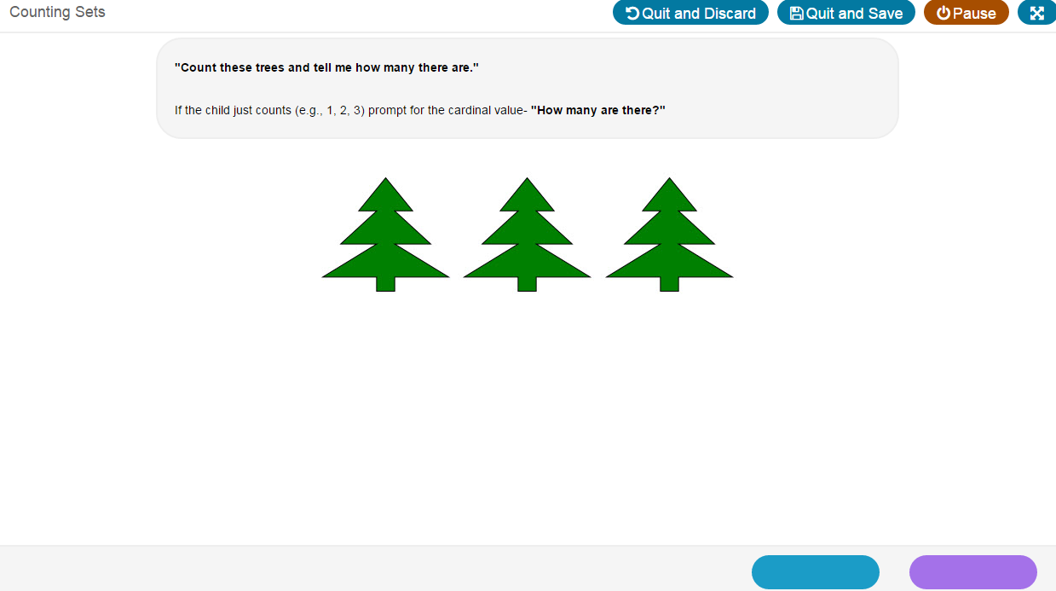
Task: Set Counting
Give the directions to the child
Ask the question
Click correct or incorrect button
Note: If the child just counts (e.g., 1, 2, 3), prompt for the cardinal value by saying, “How many are there?”
Notes:
Discuss slide: Set Counting
Note: If the child just counts (e.g., 1, 2, 3), prompt for the cardinal value by saying, “How many are there?”

Slide 60
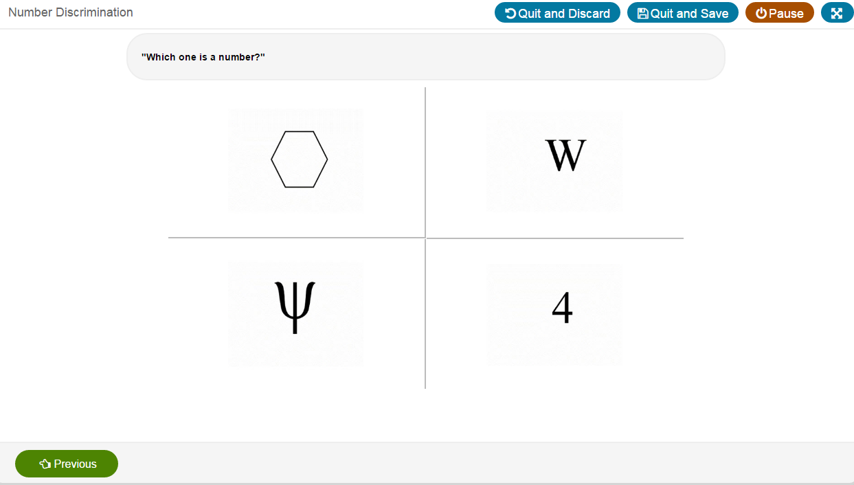
Task: Number Discrimination
Give the directions to the child.
Teachers clicks the child’s response.
Click “next” to proceed or “previous” to go back and correct and response immediately if a scoring error was made.
Notes:
Read notes on right side of Slide

Slide 61
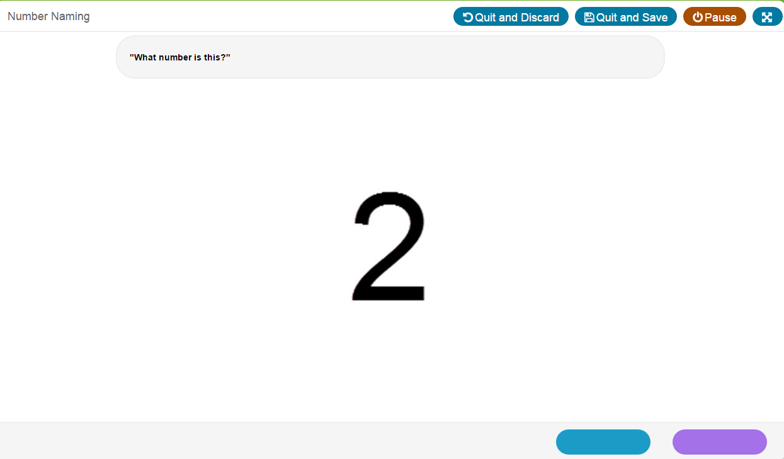
Task: Number Naming
Give the directions to the child
Ask the question
Scoring Responses: Click the correct or incorrect button
Notes:
Read notes on right side of Slide

Slide 62
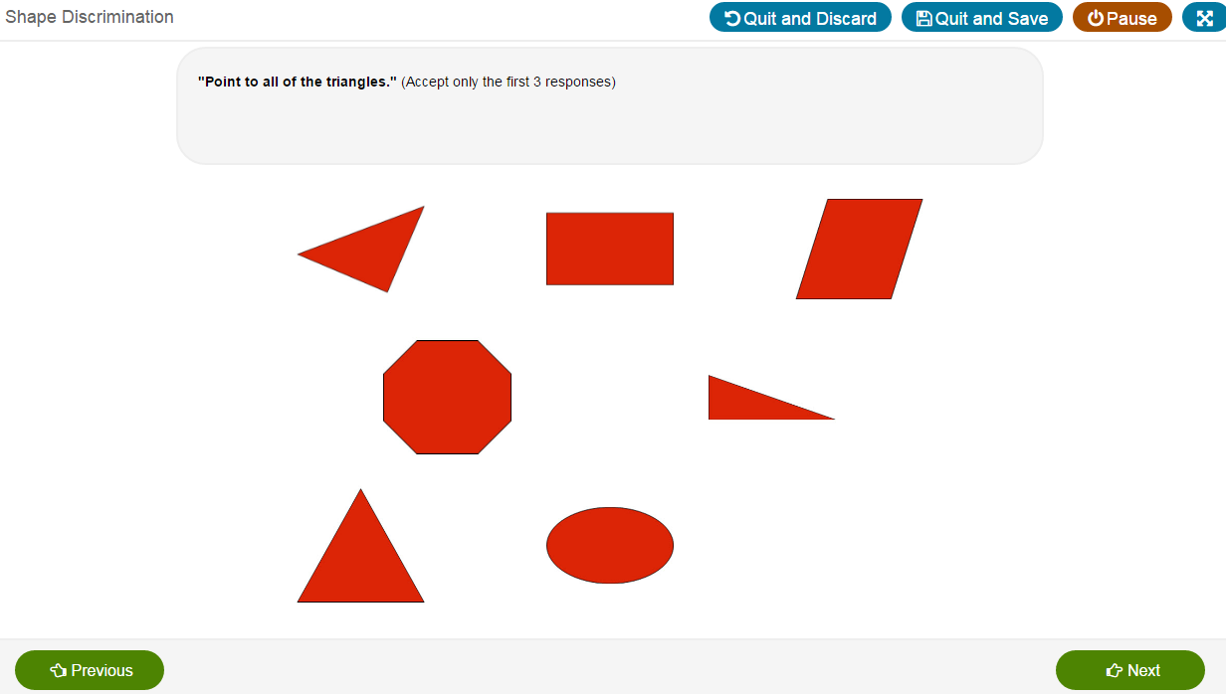
Task: Shape Discrimination
Give the directions to the child
Ask the question
Teacher highlights and clicks the child’s responses.
Click “next” to proceed or “previous” to go back and correct and response.
Note: If the child points to 1 or 2 _______, teachers can use the following prompt one time: “Is that all of them?”
Notes:
Give the directions to the child. Ask the question
Teacher highlights and clicks the child’s responses.
Click “next” to proceed or “previous” to go back and correct and response.
Note: If the child points to 1 or 2 _______, teachers can use the following prompt one time: “Is that all of them?”

Slide 63
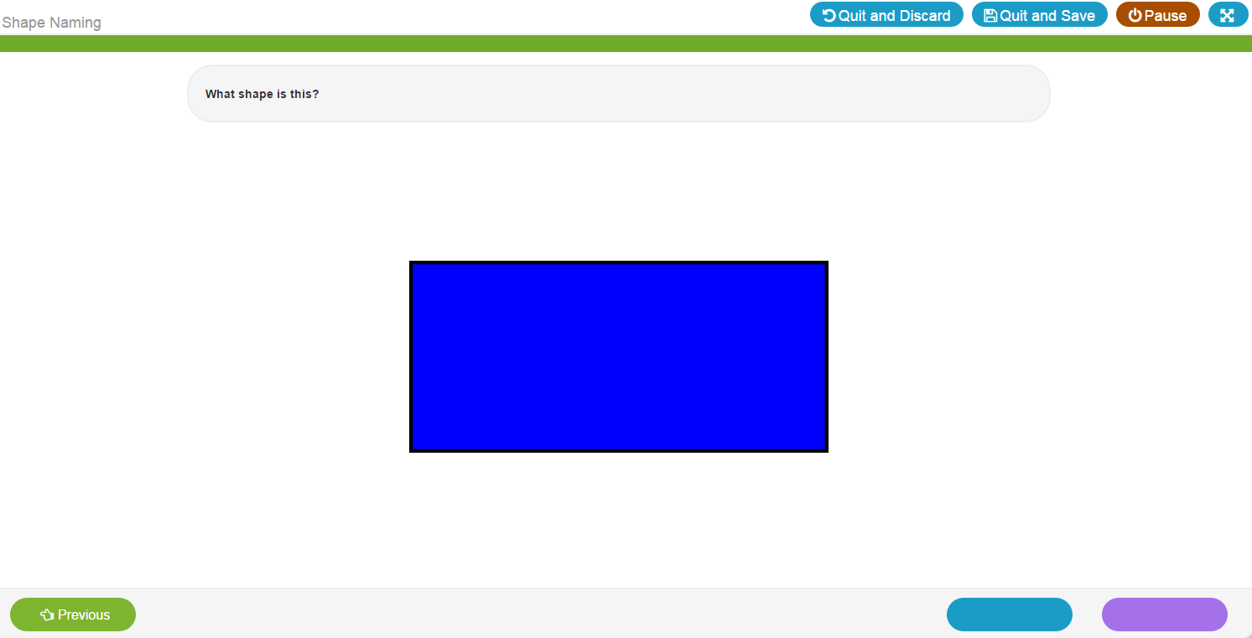
Task: Shape Naming
Give the directions to the child & ask the question
Scoring Responses:
Click blue if the student gave the incorrect response.
Click purple if the student gave the correct response.
“Previous” button allows you to go back and correct a response.
Notes:
Read notes on right side of Slide

Slide 64
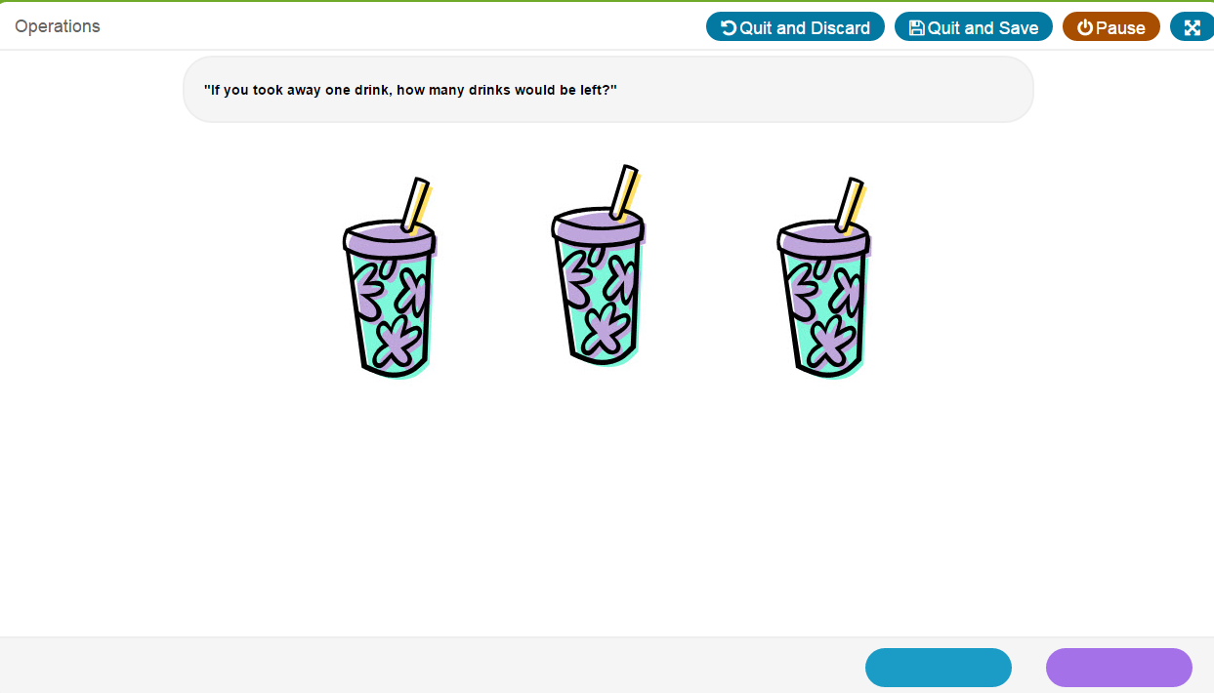
Task: Operations
Give the directions to the child
Ask the question
Click correct or incorrect button
“If you took away one drink how many would be left?”
Notes:
Read notes on right side of Slide

Slide 65
Task: Patterns
Give the directions to the child
Ask the question
Click correct or incorrect button

Slide 66
Patterns Results Page
Notes:
Discuss Slide

Slide 67
Task: Real World
Notes:
Note: you can return to the previous task to change response.

Slide 68
Quit and Save
Notes:
You can stop assessment and resume by clicking quit and save. Quit and discard deletes all data collected from the task.

Slide 69
Pause
Notes:
You can pause the assessment. Clicking pause will direct you to continue, quit and save or quit and discard. Unattended log in to the CLI Engage platform will time out after 10 minutes. If you think you’ll be away for longer than that time you should as a minimum quit and save.

Slide 70
Closing Screen for Student
Notes:
Discuss Slide

Slide 71
Results Screen
Notes:
Correct responses are indicated by a “1” incorrect responses are noted with a “0”

Slide 72
Math Administration Video
Click link to view:
https://content.jwplatform.com/previews/0GEfg6YZ-3dQYJPp5
Notes:
Watch Video-Discuss concerns from video assessment….

Slide 73
Math Group Activity
Log into the ASSESSMENT PRACTICE AREA and click on any of the Math Components.
Practice each Math Component on your own.
Notes:
Note: Participants may discuss afterwards if on an on-line discussion.

Slide 74
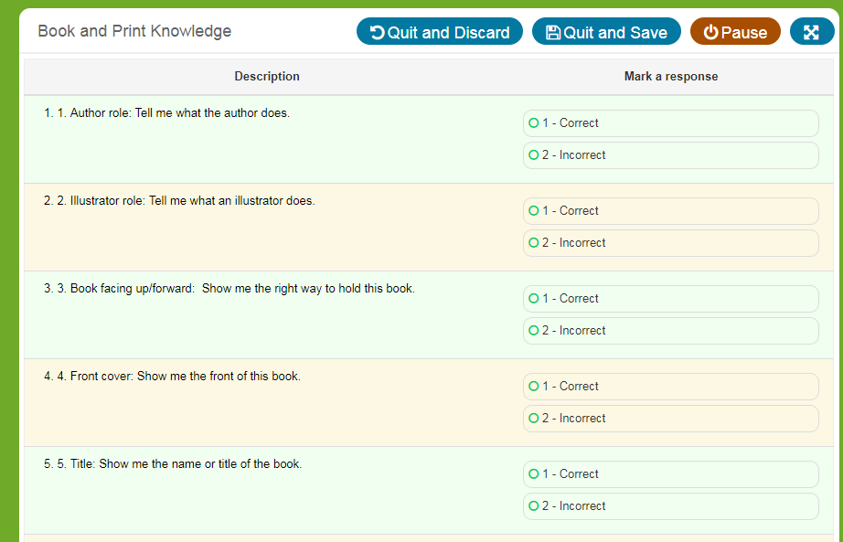
Book & Print
Book and Print Checklist: observes the child’s engagement and awareness of books and print.
Select a book with these features:
Print on every page
At least one page with multiple lines of print
No more than three lines of print on each page
Print that moves from left to right
Teacher gives directive and selects “Correct” or “Incorrect” based on the student’s response
Notes:
-Auditory/No screen prompts for students.
Note a book is needed to complete this assessment with the child present but they do not need to see the screen. The assessor will enter responses from the student.

Slide 75
Book and Print Administration Video
Click link to view:
https://content.jwplatform.com/previews/pnFjdK4A-3dQYJPp5
Notes:
Watch Video and Discuss

Slide 76
Book and Print Group Practice
Log into the ASSESSMENT PRACTICE AREA and click on the Book and Print Assessment.
Practice the Book and Print assessment on your own.
Notes:
Note: Participants may discuss afterwards if on an on-line discussion.
For training and practice have each assessor bring the following to the training session:
A children’s book that meets this criteria. Print on every page, At least one page with multiple lines of print, No more than three lines of print on each page, Print that moves from left to right

Slide 77
Science and Social Studies
Each item contains a scripted question that the child answers by pointing to one of 3 pictures (receptive task).
There are no practice items.
Follow the prompt on the screen and record the response by clicking or touching the item the child selected as the answer.
This is an untimed test, but if the child does not provide a response after about 10 seconds, move on to the next item (e.g., “OK, let’s try another one”) by clicking an incorrect response.
Notes:
Say:
The Science and Social Studies assessments are receptive tasks. Science contains 21 items and in social studies there are 15 items. For each item, the child is asked a question and presented with color illustrations of three possible answer choices. For example, with a picture of a butterfly presented, the examiner would say: “This butterfly is all grown up. Which picture shows how it looked when it was young?” The child points to one of three answer choices (A-a caterpillar; B-a chick; C-a tadpole) to respond and the examiner records the response.
Science measures four disciplinary core ideas: physical sciences, life sciences, earth and space sciences, and engineering and technology applications of science. Social Studies measure these topics addressed in the Texas pre-Kindergarten Guidelines: self, family, and community; people and the environment; and history and events.
Read Slide.

Slide 78
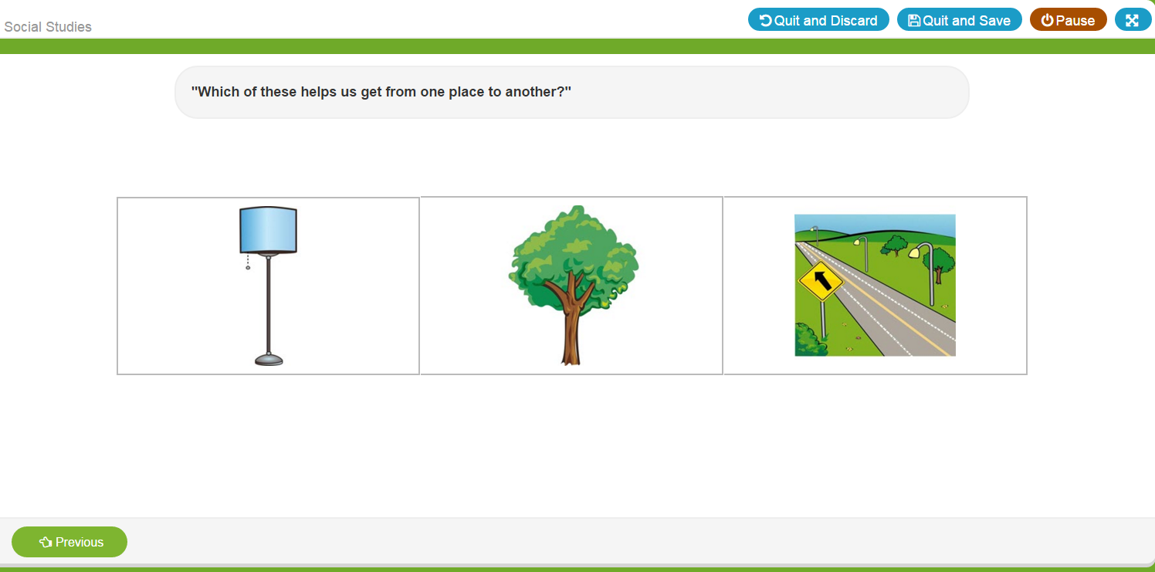
Sample Item
The teacher prompts are given on the screen and will guide the teacher through the assessment.
Click to select the response given by the student.
“Previous” button allows you to go back and correct a response if a scoring error was made.
Notes:
Read right side of slide

Slide 79
Results Screen
Notes:
Scored correct responses are indicated by a “1” and incorrect by a “0.” The item picture is also seen under response.

Slide 80
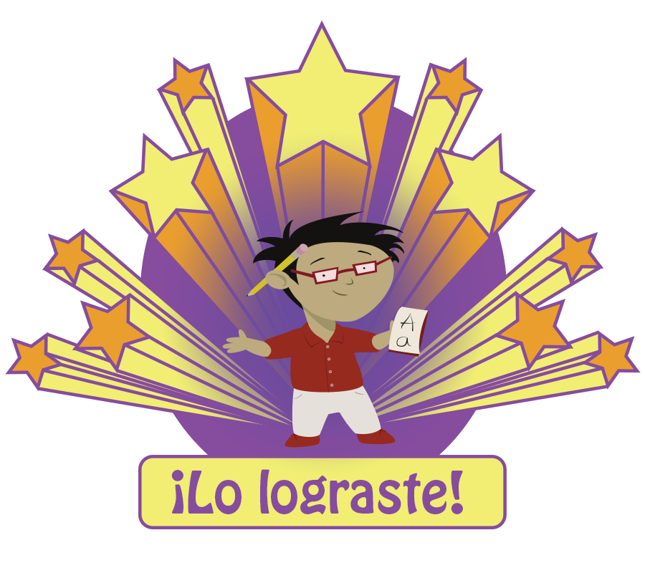
Closing Screen for Student
Notes:
Completion screen after administration

Slide 81
Observables
The Observable assessment is given separately from the other sections.
The Observables can be used to help support a child’s portfolio.
Record notes about specific behavior.
Label notes with a date and time.
Note specific interests and strengths as well as areas of weakness.
The components of the Observables include:
Social Screener
Early Writing Checklist
Physical Development and Health
Approaches to Learning
Speech Production and Sentence Skills
Motivation to read
The child does not need to be present during the completion of an observable checklist.
Notes:
Say:
Use ongoing, systematic observations of a child’s behaviors to complete the checklist. A portfolio or anecdotal note-taking system can facilitate this assessment. Teachers often document the following types of notes related to the behaviors:
The date
The setting (e.g., recess, library center, block center)
Whether support or scaffolding from the teacher or another child was needed
How often the behavior occurs
In considering the rating for each item in the checklist, evaluate whether a behavior is:
Rarely: The child never or rarely demonstrates the behavior. (0 point)
Sometimes: The child sometimes demonstrates the behavior, but is inconsistent or requires assistance. (1 points)
Consistently: The child consistently demonstrates the behavior. (2 points)
Tap or click a rating for every item to record a complete checklist.
Review the slide.

Slide 82
Observables as Portfolio Building Tools
Tailor classroom and activities to meet children’s needs
Become thoughtful observers
Enhance parent conferences
Share information with supervisors, advisors, and coaches
Remember important child information
Notes:
A teacher’s recorded observations, gathered across time, can help with:
Tailoring classroom environment and activities to meet children’s needs.
Track a child’s social, cognitive, and emotional development.
Identify a child’s strengths and interests.
Share with parents, supervisors, advisors, and coaches.
Make modifications in the curriculum.
Once this information is collected, a teacher can create a portfolio of information on the student. It will provide both the teacher and the parent a picture of a student’s learning, and reflect his/her progress in a particular area.

Slide 83
Observable Components
Social Screener: observes the child’s social and emotional development.
Early Writing Checklist: observes a child’s use of writing in the classroom.
Physical Development and Health
Approaches to Learning
Notes:
Approximate time to administer is 2 minutes per checklist per child

Slide 84
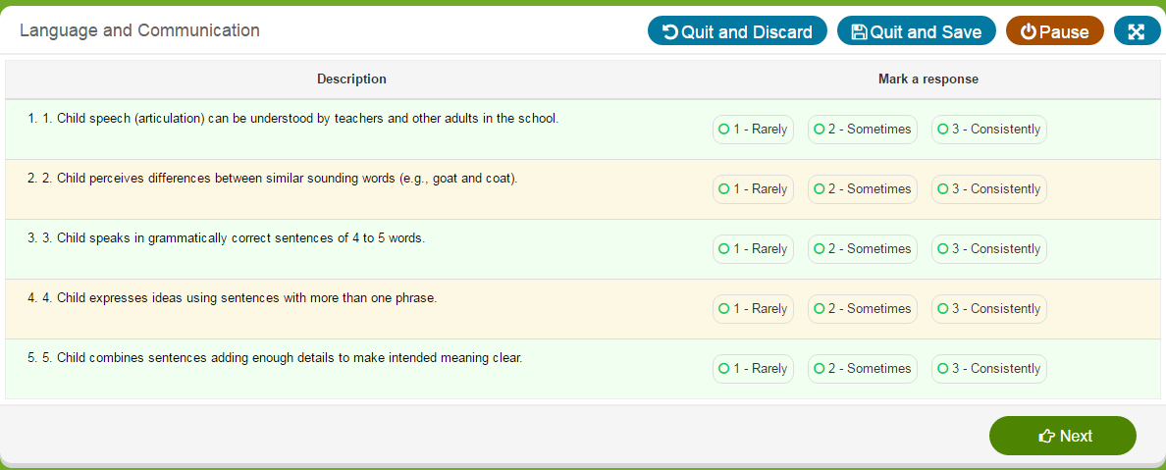
Sample Observables Checklist
Mark each item as you observe the behaviors using the following criteria:
1. Rarely: The child never or rarely demonstrates the behavior
2. Sometimes: The child sometimes demonstrates the behavior
3. Consistently: The child consistently demonstrates the behavior
Notes:
SAY:
To begin a checklist, click “launch” next to the child’s name on the child summary page.
-The scores are 0 for rarely , 1 for sometimes and 2 for consistently on the assessment you’ll see: option #1=rarely, #2=sometimes, #3 = consistently
Click “next” to continue.
You should refer to at least three weeks of observation, anecdotal notes, running records, other feedback etc. to make a determination on the rating scale.

Slide 85
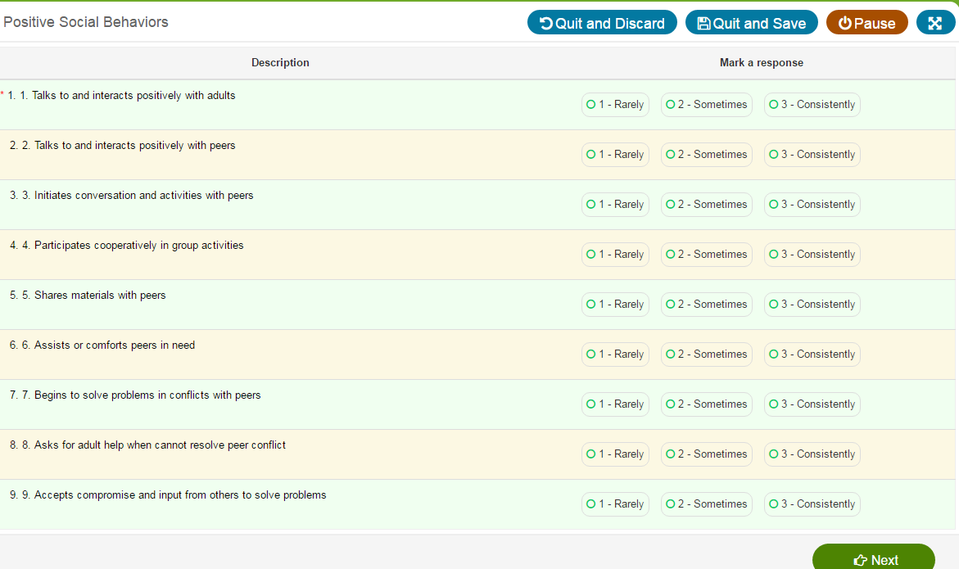
Sample Observables Checklist
Mark each item as you observe the behaviors using the following criteria:
1. Rarely: The child never or rarely demonstrates the behavior
2. Sometimes: The child sometimes demonstrates the behavior
3. Consistently: The child consistently demonstrates the behavior
Notes:
SAY:
To begin a checklist, click “launch” next to the child’s name on the child summary page.
-Select 1, 2, or 3 RARELY, SOMETIMES AND CONSISTENTLY Click “next” to continue.
You should refer to at least three weeks of observation, anecdotal notes, running records, other feedback etc. to make a determination on the rating scale.

Slide 86
Observables Administration Video
Click link to view:
https://content.jwplatform.com/previews/3ocuKlis-3dQYJPp5
Notes:
Begin by viewing the instructional video on Observables and then have teachers log into the system and practice any part of the checklist. After completing discuss with teachers.

Slide 87
Observables Group Practice
Log into the ASSESSMENT PRACTICE AREA and click on any of the components in the Social Emotional checklist.
Practice each Social Emotional checklist component on your own.
Note: Participants may discuss afterwards if on an online discussion.
Notes:
Read and Discuss

Slide 88
Early Writing Checklist
Notes:
Here you see the early writing checklist as it appears in the assessment. The guidance, as in all checklists, recommends using ongoing, systematic observations of a child’s behaviors to complete the Early Writing checklist. A portfolio or anecdotal note-taking system can facilitate this assessment. Teachers often document these types of notes related to the behaviors:
The date
The setting for example, at center time, in the writing center or in small group.
Whether support or scaffolding from the teacher or another child was needed
And How often the behavior occurs
In considering the rating for each item in the checklist, evaluate whether a behavior is:
Rarely: The child never or rarely demonstrates the behavior. (0 point)
Sometimes: The child sometimes demonstrates the behavior, but is inconsistent or requires assistance. (1 points)
Consistently: The child consistently demonstrates the behavior. (2 points)
Tap or click a rating for every item to record a complete checklist.

Slide 89
Early Writing Checklist Results Page
Notes:
What does this information reveal?

Slide 90
Early Writing Checklist Individual Student Report
Notes:
When viewing a summary report for the early writing checklist for this student we see that they did not meet the benchmark and require more support.
If this is wave 2 of a student summary what will be next steps for instructional planning?

Slide 91
Assessment Resources
Notes:
Locate HOW TO GUIDES
Find the resources such as the Spanish and English language Scoresheets for each wave of vocabulary administration. Find specific instructions with step by step on how to view reports. Find the Story retell response record sheet. Here you will also find instructions for offline assessment, printable parent reports and of course the CPM User Guide. You will also find HTG for every CPM report.

Slide 92
Data Reports
Notes:
Now let’s take a closer look at reports.

Slide 93
Four Types of Reports
1
Completion - Tracks completion of required assessments
2
Growth - Allows districts, communities, and teachers to view children’s gains over time
3
Summary - Allows districts & communities to view children’s performance across all subject areas
Group - Groups children with scores below age-related benchmarks and recommends activities for further skill development
4
Notes:
Say:
CIRCLE Progress Monitoring provides you with several different Reports.
(Review each type of report as listed on the slide.)
We will look at each of these reports in detail.
Completion Report: tracks completion of required assessments
Growth Report: allows districts, communities, and teachers to view children’s gains over time
Summary Report: allows districts and communities view children’s performance across all subject areas BY CLASSROOM or INDIVIDAUL STUDENT
Group Report: groups children with scores below age-related benchmarks and recommends activities for further skill development

Slide 94
Completion Reports
Notes:
Completion Reports
Say:
Completion reports allows the teacher to see students’ completed testing in selected measures .
NOTE: You can also review the report by % of students tested.

Slide 95
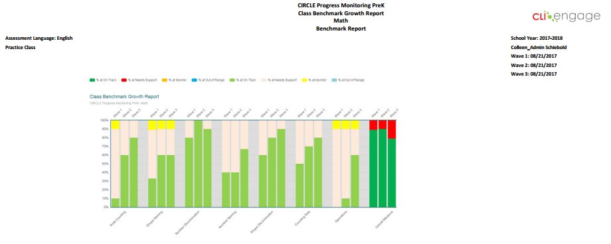
Growth Reports
Notes:
Class growth reports can be created by selecting the measures you want to see and the waves to compare.

Slide 96
Hover to see percentages
Notes:
Before export you can move your cursor over the bars to view percentages.

Slide 97
Adjust proficiency bars
Notes:
Before export you can also manipulate the colored bar graph key by deselecting proficiency ranges. In this report example we see only those students older than 4 that need support.

Slide 98
Exports Reports to PDF
Notes:
Click the export button to generate a PDF

Slide 99
Average scores
Notes:
The growth report also produces an average score report. In this report example, you see the average correct scores for all students in the class for these select measures. These scores are from two different time points. At the top of each bar is the maximum number of correct answers.

Slide 100
Class Summary
Provides:
Overview of assessments for your class
Snapshot of your children’s literacy and math skills
Notes:
Say:
The class summary shows each child in the classroom and their scores on each part of the CIRCLE Progress Monitoring . This will give you an overall picture of the assessment for your entire class. It is a snapshot of the student’s skills.

Slide 101
Summary Reports
Notes:
As soon as an assessment measure is completed , the results show on the class view of students page. In this class view you see the entire class color coded by benchmark
This will give you an overall picture of the assessment for your entire class. It is a snapshot of the literacy and math skills of your children.

Slide 102
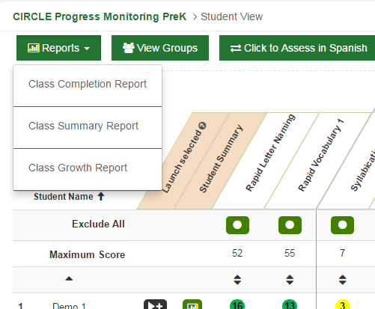
Summary report
Notes:
You can view the summary report from the report drop down. This creates a report you can print/save.

Slide 103
Class Summary Report
Notes:
This summary report shows the entire class color coded by benchmark
The class summary shows each child in the classroom and their scores on each part of the entire assessment. This will give you an overall picture of the assessment for your entire class. It is a snapshot of the literacy and math skills of your children.

Slide 104
Benchmark Report for Entire Class
Notes:
Remember: Each assessment task yields a separate score. For most tasks that are broken into separate subtasks (e.g. social and emotional), a composite score is calculated from separate subtask scores. An exception to this rule is the Phonological Awareness task, whose composite score is drawn from four core subtasks only; the remaining three subtasks are considered optional. Similarly, the two optional math items (Patterning and Real World) are not included in the composite score.

Slide 105
View/Print Individual Student Reports or Entire Class

Slide 106
Summary Selection Page
Notes:
You can select the measures that you want to have included in the report.

Slide 107
View class scores or benchmark reports

Slide 108
Class Summary Report
Notes:
This summary report shows the entire class color coded by benchmark
The class summary shows each child in the classroom and their scores on each part of the assessment. This will give you an overall picture of the assessment for your entire class. It is a snapshot of the literacy and math skills of your children.

Slide 109
Grouping Tool
Provides:
Recommended children for small group instruction
Small group activities
Notes:
The grouping tool breaks children into groups for you based on their assessment results. The groups will contain children that have not yet reached the “satisfactory” level for each skill. These children need more practice with certain skills and will benefit from small group instruction. Suitable small group activities from the CIRCLE Online Activities are listed on the View Groups button.

Slide 110
Grouping Tool
Notes:
Ask: If you see more than half of your children in a certain group, what does that mean? (You need to incorporate that skill into more large group instruction.)
(Consider showing a sample Group)

Slide 111
View Groups

Slide 112
Click on Comment Bubble
2
1
Notes:
Click on the comment bubble to add a note to the grouping tool results

Slide 113
Your Note Appears Once Saved

Slide 114
Custom Groups
Notes:
You can also create a customized group that may include children from the class who were NOT in red or sub groups from the students that are needing support.

Slide 115
Create Custom Group from List of Names

Slide 116
Creating Customized Groups
Notes:
Add a name for the custom group.

Slide 117
Select From List
2
1
Notes:
To select children from the class who were not in red, first click on the plus sign icon. A list of the entire class will appear. Then click on any of the children who you like to be in the customized group.

Slide 118
Drag and Drop
Notes:
To drag and drop, click on the plus sign to move the learner to the customized group.

Slide 119
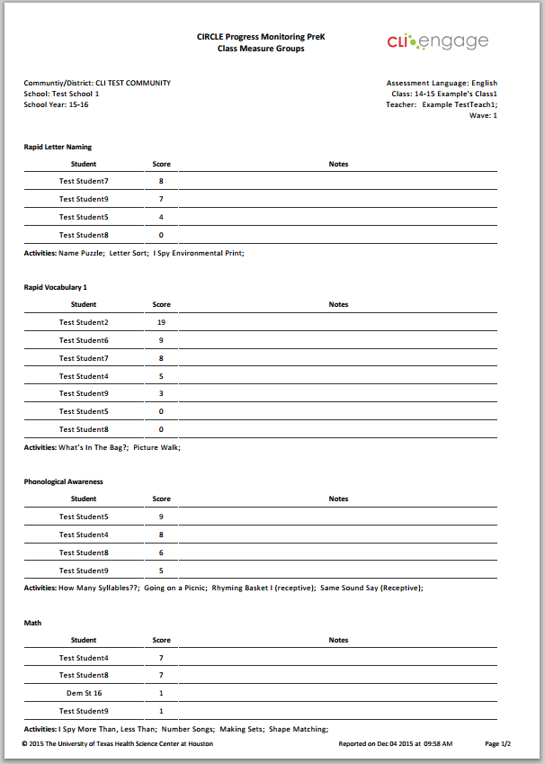
Group Summary
Components/ Subsets
Basic Data
Student(s)
Online Activities
Notes:
This is a group summary report

Slide 120
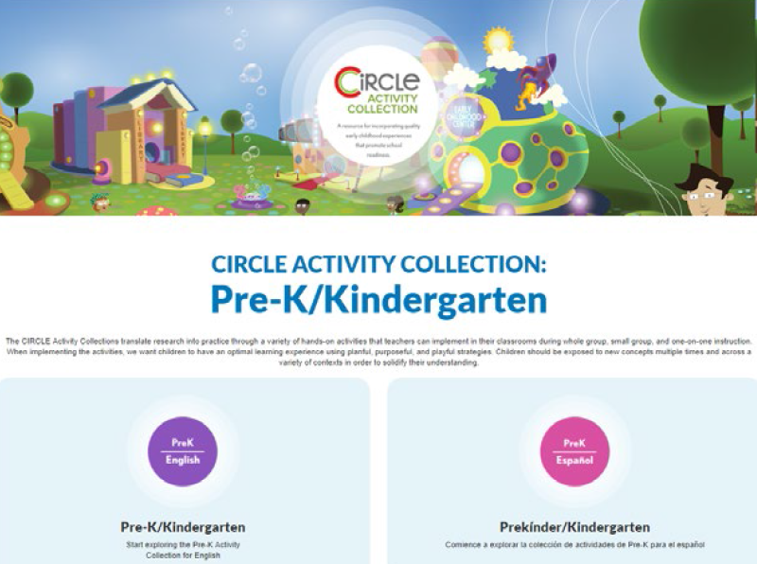
CIRCLE Activity Collection
Tied to progress monitoring results
Annotated videos of the activities performed in real classrooms
Heavy scripting to cue the teacher to best instructional practices
Notes:
CIRCLE Activity Collection
The CIRCLE Activity Collection is tied to progress monitoring results, annotated videos of the activities performed in real classrooms, and heavy scripting to cue the teacher to best instructional practices.

Slide 121
CIRCLE Activity Collection
Notes:
CIRCLE Activity Collection
This slide shows a preview of the CIRCLE Activity Collection. It includes the setting, materials, objectives, including scripting for a modeled lesson with guided practice, scaffolding and variations or extension activities. There are also alignments with both the Texas Pre-K Guidelines, Head Start Early Learning Outcomes Framework (ELOF) and the Texas Essential Knowledge and Skills (TEKS) for Kindergarten

Slide 122
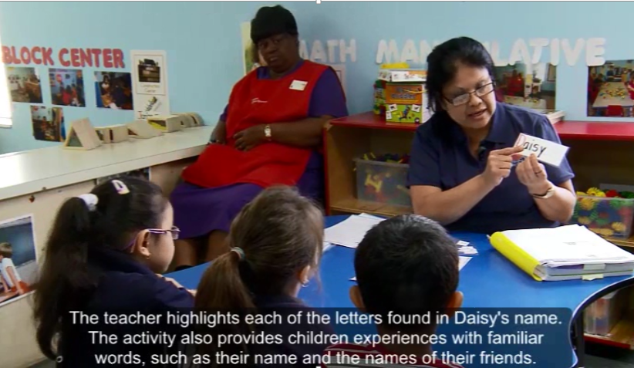
Let’s View an Activity
Click here to view the activity video.
Notes:
NAME SORT WITH GRADUAL RELEASE 8.2.6

Slide 123
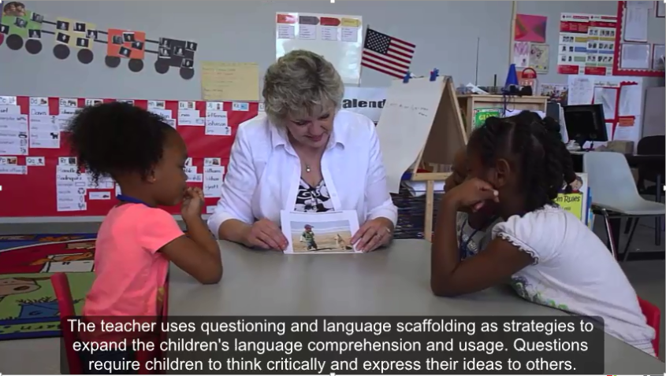
Let’s View an Activity
Click here to view the activity video.
Notes:
Oral language – picture's worth a thousand words 4.32

Slide 124
What is Response to Intervention (RTI)?
Tier 2 supplemental small groups ~15%)
Tier 1
core curriculum (~80%)
Tier 3
intensive, individualized interventions (~5%)
Notes:
Assessment allows us to know who is identified as needing more instruction from Tier 1 to Tier to Tier 3.
Progress monitoring results generate Tier 2 small groups for more targeted strategies
Tier 3 is generally not indicated from an initial screening like CIRCLE assessment, but from lack of progress in tier 2.
Children identified as at-risk receive more frequent, more intensive, and/or different types of instruction, often in small groups such as Tier 2 in thRTI framework). Continued assessment may further inform instruction, such as the need for individualized attention (Tier 1).
Scores are color-coded. Four-year old children will have “green” and “red” scores, which correspond to “satisfactory” and “emerging” skills. Three-year olds will have “green” and “yellow” scores. If more than half of your class has a “red” or “yellow” score, then you should focus on that skill in your whole group instruction.
Ask: If half your class shows a “red” or “yellow” score in Letter Knowledge, how would you address that in large group instruction? (Read alphabet books, play letter wall games, do letter knowledge transitions, etc.)
Let’s look at some ways to improve your whole group instruction in language and phonological awareness.

Slide 125
Whole Group Language Instruction
Conversations
Questions
Read-Alouds
New vocabulary
Language building strategies
Themes
Notes:
Whole group language instruction can be used to increase the skills of the entire class when needed. Whole group instruction should focus on:
Engaging children in extended conversations
Asking questions to encourage critical thinking
Reading aloud daily
Encouraging children to retell stories
Modeling use of new and unusual words
Using language building strategies (label, describe, compare, explain, link)
Discussing word meanings
Using themes (discussing topics & concepts in context)
Extending themes into centers
(Encourage participants to give additional ideas.)

Slide 126
Whole Group Phonological Instruction
Daily PA instruction
Variety of PA activities
Increase level of difficulty
Connect to themes
Books that include PA elements
PA activities in centers
Notes:
Whole group phonological awareness instruction can be used to increase the skills of the entire class when needed. Whole group PA instruction should focus on:
Engaging children in daily PA instruction
Providing a variety of PA activities based on the continuum
Increasing level of difficulty as knowledge increases
Connecting PA activities to themes
Including PA activities in children’s play
Using books that include PA elements
Providing hands-on PA activities in centers
(Encourage additional ideas from participants.)

Slide 127
Benefits of Small Group Instruction
Give children more opportunities to use language with the teacher and peers
Observe children individually
Scaffold children’s development
Meet children’s individual needs
Reduce wait time for children
Allow for more individual participation from each child
Notes:
Small group instruction is so beneficial for young children. Through small group instruction, you can:
(Read slide)

Slide 128
Planning Intervention
Use the small grouping tool
Use CIRCLE online activity collection
Utilize CLI Engage on-line Professional Development for teachers
CLI Engage CIRCLE Activity Collection
Notes:
Discuss slide -opportunities for interventions with Teachers

Slide 129
Analyzing Reports Activity
With your demo students complete Letter Knowledge, Vocabulary and Phonological Awareness assessments with at least ½ of the class below benchmarks.
Create a class summary and a group report on these 3 areas.
Review the summary and determine 3 interventions.
Notes:
Read and Discuss

Slide 130
If you need assistance…
Submit a “Help Ticket” through the CLI Engage Dashboard.
Questions will be addressed by trained CLI staff members.

